Slide 1
Panelist Training
2020-2021

Slide 2
Scope of the policy and other relevant policies
Sexual Harassment, Sexual Assault, Sexual Misconduct, Domestic Violence, Dating Violence, Stalking, and Retaliation are prohibited
Policy applies to EVERYONE
Process A and B
Student Conduct Code
Presumption of Non-Responsibility
They are NOT guilty or innocent in a hearing

Slide 3
Laws and Regs
2020 Federal Regulations
Requires LIVE Hearing
Not in person
2016 Preventing Sexual Violence in Higher Education (IL)

Slide 4
Definitions
Sexual Assault means sex offenses, including attempts, that are:
1) Forced
These acts include:
a. Forcible Rape:
○ Penetration, no matter how slight, of the vagina or anus with any body part or object, or oral penetration by a sex organ of another person, without the consent of the Complainant.

Slide 5
Sexual Assault Continued
b. Forcible Sodomy:
○ Oral or anal sexual intercourse with another person, forcibly, and/or against that person’s will (non-consensually), or not forcibly or against the person’s will in instances in which the Complainant is incapable of giving consent because of age or because of temporary or permanent mental or physical incapacity.
c. Sexual Assault with an Object:
○ The use of an object or instrument to penetrate, however slightly, the genital or anal opening of the body of another person, forcibly, and/or against that person’s will (non-consensually), or not forcibly or against the person’s will in instances in which the Complainant is incapable of giving consent because of age or because of temporary or permanent mental or physical incapacity.

Slide 6
Sexual Assault Continued
d. Forcible Fondling:
○ The touching of the private body parts of another person (buttocks, groin, breasts), for the purpose of sexual gratification, forcibly, and/or against that person’s will (non-consensually), or not forcibly or against the person’s will in instances in which the Complainant is incapable of giving consent because of age or because of temporary or permanent mental or physical incapacity.
2) Lack of Consent: Any sexual act directed against another person, without the consent of the Complainant, including instances in which the Complainant is incapable of giving consent. See definition of consent.

Slide 7
Sexual Assault Continued
3) Non-forcible
○ Incest: Non-forcible sexual intercourse, between persons who are related to each other, within the degrees wherein marriage is prohibited by Illinois law.
○ Statutory Rape: Non-forcible sexual intercourse, with a person who is under the statutory age of consent of seventeen.

Slide 8
Consent
Consistency
Be consistent in how you define it
Impartiality
Be impartial, look at facts
Policy
How does the policy define it

Slide 9
Consent Policy
Consent means a clear, affirmative, unambiguous and freely given agreement to engage in a specific sexual activity. Consent is demonstrated verbally or through actions that clearly indicate a willingness to engage in the specific sexual activity. Lack of verbal or physical resistance does not constitute consent. Consent to engage in sexual activity with one person does not constitute consent to engage in sexual activity with another person, and consent for a specific activity does not imply consent for any other activity. Use of alcohol, drugs, or other intoxicants does not diminish one’s responsibility to obtain consent.
Consent must be knowing and voluntary. To give consent, a person must be awake, of legal age, and have the capacity to reasonably understand the nature of his/her actions. Consent cannot be given by an individual who is mentally or physically incapacitated through the effect of drugs, alcohol or other intoxicants or for any other reason. Consent cannot be given when it is coerced, forced, or obtained by use of duress, fear, threats, or violence. Consent is not implied by the existence of a prior or current relationship or participation in prior sexual activity. A person’s manner of dress does not constitute consent. Consent to engage in sexual activity may be withdrawn at any time and is automatically withdrawn by a person who is no longer capable of giving consent.

Slide 10
Incapacitation
What does it look like
Slurred speech
Falling
Blacking out
Throwing Up
Trouble walking
Weird Behavior
Both parties
Did R give C alcohol

Slide 11
3 questions
Force
Could include threats, coercion
Incapacitation
Known or reasonably should have known
Can victim make decisions based on their mental/physical state
Blackouts
Clear words or actions = Consent
Silence = Not Consent, unless actions prove otherwise
Can be withdrawn
For every act
At the time of the act

Slide 12
Definitions Continued
Sexual Harassment (Educational) means conduct, on the basis of sex, that satisfies one or more of the following:
a. Unwelcome conduct determined by a reasonable person to be so severe, pervasive, and objectively offensive that it effectively denies a person equal educational access to an SIUC program or activity. Whether conduct is unwelcome is subjective and determined by the Complainant except where the Complainant is under the age of consent.
b. An employee of the University conditioning the provision of an aid, benefit, or service of the University on an individual’s participation in unwelcome sexual conduct.

Slide 13
SPOO: If it’s SPOO Discriminatory Effect is a Given
Severe
Verbal (lower level)
Touching, Force, Privacy Invasion, Violence/Threat of, Age, Explicit, Power Difference
Pervasive
Conduct or Effects of Conduct
Totality, Facts specific, Frequency, Can C remove self, Damage, Openly practices, Denies access, Persistent, Changes terms/conditions
AND
Objectively Offensive
Unwelcome, Reasonable Person, Similarly Situated, Community Standard, Don’t be too narrow

Slide 14
Sexual Harassment Continued
Sexual Harassment (Employment) means any unwelcome sexual advances, requests for sexual favors, and other verbal or physical conduct of a sexual nature when:
a. Submission to such conduct is made either explicitly or implicitly a term or condition of an individual’s employment (quid pro quo – meaning “this for that”); and/or
b. Submission to or rejection of such conduct by the individual is used as the basis for employment decisions or assessments affecting such individual; and/or
c. Such conduct has the purpose or effect of substantially interfering with an individual’s work performance or creating an intimidating, hostile, or offensive working environment (hostile environment).
Hostile environment harassment occurs when an employee is subjected to unwelcome sexually offensive conduct that is sufficiently severe or pervasive to alter their employment and creates an abusive or hostile work environment. To determine whether an environment is hostile or abusive, the university will look at the frequency of the conduct, the severity of the conduct, whether the conduct is physically threatening or humiliating, or a mere utterance, and whether it unreasonably interferes with an employee’s work performance.

Slide 15
Definitions Continued
Sexual Misconduct
means any other act of a sexual nature which disrupts or negatively impacts the educational mission of the University, including but not limited to public displays of pornography; possession, creation, or distribution of child pornography; the exchange of money, goods or services in exchange for any sexual activity; causing another person to witness or observe any sexual act without clear, voluntary consent; videotaping, photographing or otherwise recording sex acts without the clear, voluntary consent of all individuals involved or sharing that video, photo, or recording with others without the knowing, voluntary, written, consent of the other party.

Slide 16
Definitions Continued
Stalking
means engaging in a course of conduct involving two or more independent actions, which threatens or endangers the health, safety, emotional welfare, or access to academic resources or employment of another person or which would cause a reasonable person to be fearful for his/her safety, health, or emotional well-being and which does cause another person to be fearful for his/her safety, health, or emotional well-being. For the purposes of this definition course of conduct means two or more acts in which the Respondent directly, indirectly, or through third parties, by any action, method, device, or means, follows, monitors, observes, surveils, threatens, or communicates to or about a person, or interferes with a person’s property. Substantial emotional distress means significant mental suffering or anguish that may but does not necessarily require medical or other professional treatment or counseling.

Slide 17
Definitions Continued
Dating Violence
means violence, on the basis of sex, committed by a person, who is in or has been in a social relationship of a romantic or intimate nature with the Complainant. The existence of such a relationship shall be determined based on the Complainant’s statement and with consideration of the length of the relationship, the type of relationship, and the frequency of interaction between the persons involved in the relationship. For the purposes of this definition dating violence includes, but is not limited to, sexual or physical abuse or the threat of such abuse. Dating violence does not include acts covered under the definition of domestic violence.

Slide 18
Definitions Continued
Domestic Violence
means any act of violence, on the basis of sex, committed by a current or former spouse or intimate partner of the Complainant, by a person with whom the Complainant shares a child in common, or by a person who is cohabitating with, or has cohabitated with, the Complainant as a spouse or intimate partner, or by a person similarly situated to a spouse of the Complainant under the domestic or family violence laws of Illinois or by any other person against an adult or youth Complainant who is protected from that person’s acts under the domestic or family violence laws of Illinois. To categorize an incident as Domestic Violence, the relationship between the Respondent and the Complainant must be more than just two people living together as roommates

Slide 19
Definitions Continued
Retaliation
means any act of reprisal, including negative or otherwise unwarranted treatment, related to the reporting of or participation or decision not to participate in a complaint of a violation of this policy or any related policy or procedure. Retaliation may include, but is not limited to:
1. Taking negative tangible employment or educational actions against a person;
2. Taking actions that substantially interfere with or have a chilling effect on the employee's or student's ability to participate fully in and benefit from the work or educational environment;
3. Failing to provide assistance or instruction that would otherwise be provided;
4. Failing to fairly and/or objectively evaluate an employee's or student's performance;
5. Failing to record an appropriately earned grade for a student; or
6. Otherwise sabotaging an employee's or student's performance or evaluation.

Slide 20
Reporting
safe.siu.edu
Mandated Reporting
No mandated complaint
Official W/ Authority
Confidential Advisor
Other confidential sources

Slide 21
Process
Complaint
SAFE/Police Report/Complaint
Assessment
Jurisdiction
Is it actually a possible violation
Speak with Complainant
Get info to write complaint (their story)
Witnesses, Evidence
They may decline to speak to us and get supportive measures
They may speak to us, only want supportive measures
If either of these, the R is not notified (usually)

Slide 22
Process Continued
Complaint
Signed by C (or TIXC)
Investigation
Speak to R
Witnesses, Evidence
Speak to Witnesses
Evidence
Ask for documentation
Write statements
Send to parties, witnesses to review

Slide 23
Process Continued
Write Draft Report
30 days
Send to Parties
Electronic
10 business days
Send back statements
Write final report
Send to TIXC to read
Send to parties
At least 10 more business days
Hearing

Slide 24
Informal Resolution
At any time in process, before a decision
Both parties must agree, in writing
Must have formal complaint first
Negotiated
Agreement to settle

Slide 25
Your Role
Uphold Process
Chair
Panelists
Maintain standards
Be impartial
Ask Questions
Follow guidelines set by policy and procedure
Don’t have to agree with policy, but must uphold the policy

Slide 26
How to Conduct Questioning
Who, what, when, where, why
Relevant facts
Corroboration
Fill in any gaps you may have from the report
Don’t be Perry Mason!
Be kind, patient, ask open ended questions

Slide 27
Questioning Continued
If you have a gap, you can ask the investigator why it wasn’t in report (maybe they didn’t feel it was relevant, but you do)
You may then have to ask one/both of the parties the question as well
If it doesn’t have anything to do with whether a violation occurred, it’s not a good question
Why did you get in the car?
Not good
Victim blaming
Does it matter to whether or not X occurred
Keep questions short
People in hearings are frazzled and have short attention spans or may not be able to answer complex questions
May have follow up questions

Slide 28
Questions Continued
May want to ask clarifying questions too
Be neutral and flexible
LISTEN Carefully
You can summarize their statements and ask if you are correct
Don’t act shocked!
You will hear A LOT of stuff. Usually sexual, sometimes weird. Be prepared to look like they just told you their coffee order! Stay cool!

Slide 29
Pre Hearing Meetings
May be asked for
Either party
Usually the Chair will do
To answer questions
“Motions”
May want to ask if a question would be allowed
Opportunity to discover if there are any issues, if there are any witnesses that do not need to be called (stipulated), go over Advisor guidelines

Slide 30
What you as a hearing officer should do before the hearing
Read Complaint
Read Policy
Read Report
More than once?
Make sure you look at appendix!
Make notes to ask questions
Note who you should ask what
Note what you want to know and why (Is it relevant?)

Slide 31
Hearing Live, not in person
Chair
Panel
Script
Parties
Advisors
Witnesses
Investigators
Police Officers
Etc.
Recorded

Slide 32
Hearing Panel
Decides whether there is a violation or not
Decides the sanctions in Process A
Also process B if the respondent is a student
Will send Notice of Outcome to TIXC
What Policy was/was not violated
Procedural Steps taken
Findings of Facts
Conclusions
Sanctions
Remedies
TIXC will send to parties

Slide 33
Rights under Regs
Right to present witnesses
Right to Due Process
Right to know evidence for/against
Gather and present evidence
Have an advisor
Written notice
Inspect and review evidence and final report
Right to include “directly related evidence” to hearing, even if investigator left out of report
Ask, through and advisor, relevant questions at hearing

Slide 34
Due Process
Legal protections ensuring that no one will be deprived of education or employment without fairness in process
Substantive
Due process in decision
Impartiality, fair, decision based on fact, etc.
Procedural
Due process in process
Notice, consistency, allegations provided, etc.

Slide 35
Due Process Continued
Notice
Writing
Opportunity to be Heard
Information to Mount a Defense
Present evidence/Witnesses
Fair/Impartial Hearing
Be Given All Evidence
Have Advisor
Now Cross

Slide 36
Advisors
Must have for Hearing
One will be appointed if party doesn’t have one
Cross
Other roles may be limited
Must follow guidelines
Relevant
Professional
If they won’t ask questions, we have to find someone who will
They can choose anyone
Attorney, mother, etc.
Panel is authority over the Advisor, make them play by the rules

Slide 37
Cross-Examination
Parties and Witnesses must submit themselves to Cross or their statements cannot be used
No inferences can be made if someone doesn’t submit
Can’t be in writing
Submit…no questions?
Can admit evidence that wasn’t a statement
Video
Relevance of questions are determined by Chair of Panel
Ask Advisor why it’s relevant
May go to credibility
If the question has already been asked (by panel) and answered, Chair can ask why they are being asked again and can deny it)
Chair must explain their decision
Irrelevant, unduly repetitious, or abusive
MUST have Advisors for this
Advisors can be reprimanded or removed from hearing is they don’t follow the rules

Slide 38
Evidence (Including Testimony)
Must be relevant
No rules of evidence, other than relevance
Does it help prove or disprove
Don’t have to agree with investigators
Don’t really ask investigators what they believe, that shouldn’t be used in your decision

Slide 39
Evidence Continued
Anyone who was interviewed during investigation must be at hearing in order for panel to use their statements for making determination
Can be any type of evidence
Credible/Reliable
Don’t get too caught up in irrelevant stuff (memory errors, etc)
Trauma Brain
Look at accuracy and reliability
Things may not seem truthful, doesn’t mean they aren’t
Plausible, Possible, can it be corroborated (especially by a witness with no dog in the fight), why would they lie, body language, pattern

Slide 40
Evidence Continued
Some evidence is worth more
Video (really good)
Circumstantial (ok)
Witness (depends on the witness)
Documentation (really good)
Medical (is it really relevant, only get some much info, privileged info must have permission to have or use)
Avoid
Character Evidence
Impact Statements (unless sanctioning)

Slide 41
Relevance
Must be evidence directly related to the possible violation, unless to prove a pattern
Do not consider character of the parties
Not relevant per regs
Questions/Evidence about the Complainant’s sexual predisposition or prior sexual behavior, unless such questions and evidence about the Complainant’s prior sexual behavior are offered to prove that someone other than the Respondent committed the conduct alleged by the Complainant, or if the questions and evidence concern specific incidents of the Complainant’s prior sexual behavior with respect to the Respondent and are offered to prove consent.

Slide 42
Deliberations
ONLY decision makers
No recordings
Shred notes
Look at policy
Look at complaint
Go through evidence
Facts
Vote
Preponderance
Violation?
If yes, sanction
Impact statements can be made by both parties
Stop, prevent, remedy (protect C and Community)

Slide 43
Preponderance of the Evidence
More likely true than not
Presumption of Non-responsibility
Presumption of Good Faith

Slide 44
Totality of the Circumstances
Sex Based
Mere utterance
Reasonable person standard
1st amendment
Humiliating, Threatening, Facts, What were the effects of the conduct
SPOO (for students)
See Page 13

Slide 45
Sanctions
Depends on whether they are a student, faculty, or staff
Student Conduct Code
May look at past violations in sanctioning
Collective Bargaining Agreement
State Laws
May include Suspension, Expulsion, Termination

Slide 46
Written Findings
Policy violated
Procedural steps taken
Rational for finding
Sanctions
Remedies
Appeal process
Give to TIXC
Send to parties at the simultaneously
Final after appeal or date of appeal

Slide 47
Appeals
Sanctions are stayed while the appeal is in process
Grounds
Procedural Irregularity
New Evidence
Conflict of Interest or Bias
Sanctions are disproportionate
Filing
Writing to TIXC
7 business days from Notice of Outcomes
Single Decision Maker

Slide 48
Appeals Continued
Other parties, advisors, TIXC, investigators will be given the request for appeal
Non-appealing Parties have 7 days to submit response to TIXC
Appeal Chair receives
If it doesn’t fit a ground of appeal, it’s thrown out
If it does Appeal Chair will look at it and either
Affirm
Modify
Remand

Slide 49
Implicit Bias http://kirwaninstitute.osu.edu/research/understanding-implicit-bias/
Implicit bias: attitudes or stereotypes that affect our understanding, actions, and decisions in an unconscious manner.
activated involuntarily and without an individual’s awareness or intentional control
feelings and attitudes about other people based on characteristics such as race, ethnicity, age, and appearance
develop over the course of a lifetime beginning at a very early age through exposure to direct and indirect messages

Slide 50
Disparate Treatment and Impact
Disparate treatment occurs where members of a protected class have been treated differently than others (purposely)
Disparate Impact occurs when a certain practice makes it more difficult for a member of a certain protected class (unintentionally)

Slide 51
Confidentiality and Privacy
Keep everything as private as possible
Need to know
FERPA
Employment Rules
Cannot guarantee Confidentiality (see above)

Slide 52
Fairness and Equity /www.cui.edu/academicprograms/education/perfecting-the-practice/blog/post/how-to-balance-equity-equality-and-fairness
Equal is defined as the same or exactly alike. [Equality]
Fair is defined as just or appropriate in the circumstances. [Fairness]
Equity is defined as the quality of being fair and impartial.

Slide 53
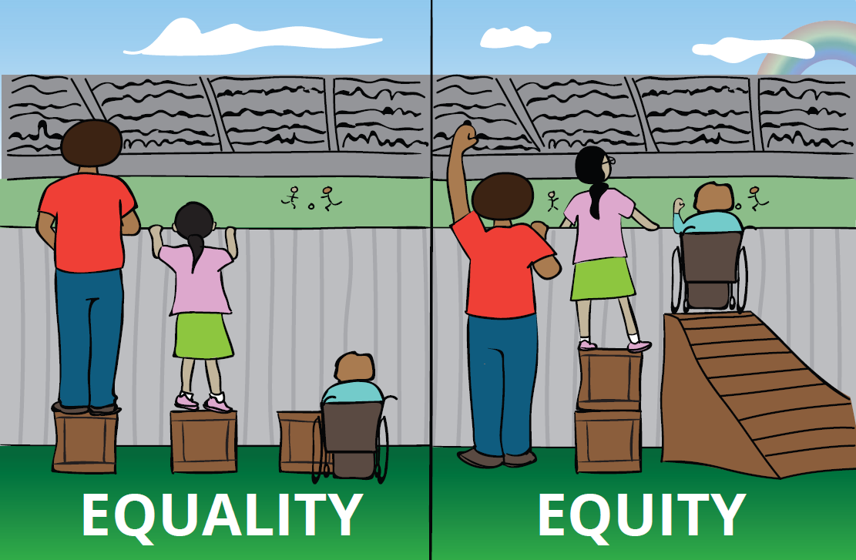
Equity v. Equality

Slide 54
Conflict of Interest and Bias
Conflict of Interest: a conflict between the private interests and the official responsibilities of a person in a position of trust (Merriam-Webster)
Bias: a particular tendency, trend, inclination, feeling, or opinion, especially one that is preconceived or unreasoned, unreasonably hostile feelings or opinions about a social group; prejudice
All pool members must be free from bias and conflicts
Parties can ask that pool members be removed if they feel there is a conflict or bias

Slide 55
Technology
Zoom
Microsoft Teams
File sharing platforms

Slide 56
Record Keeping
7 years
Keep all records

Slide 57
Questions?

